Slide 1

WAY TO ENTERPRISE
AWS
VTI ACADEMY
Author: duy.nguyenngoc1@vti.com.vn

Slide 2
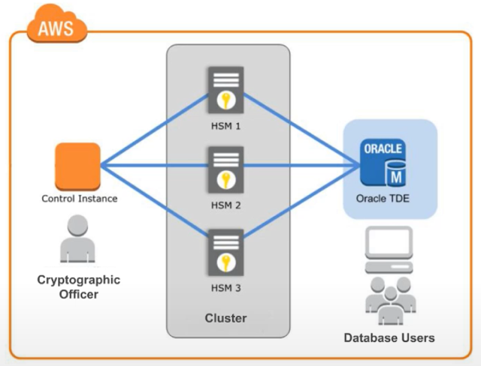
CloudHSM Service
Stands for Cloud Hardware Security Module
Is a service that allows you to create & store & manage customer's private keys
AWS will not have access to the keys
Tutorial: https://docs.aws.amazon.com/cloudhsm/latest/userguide/introduction.html

Slide 3
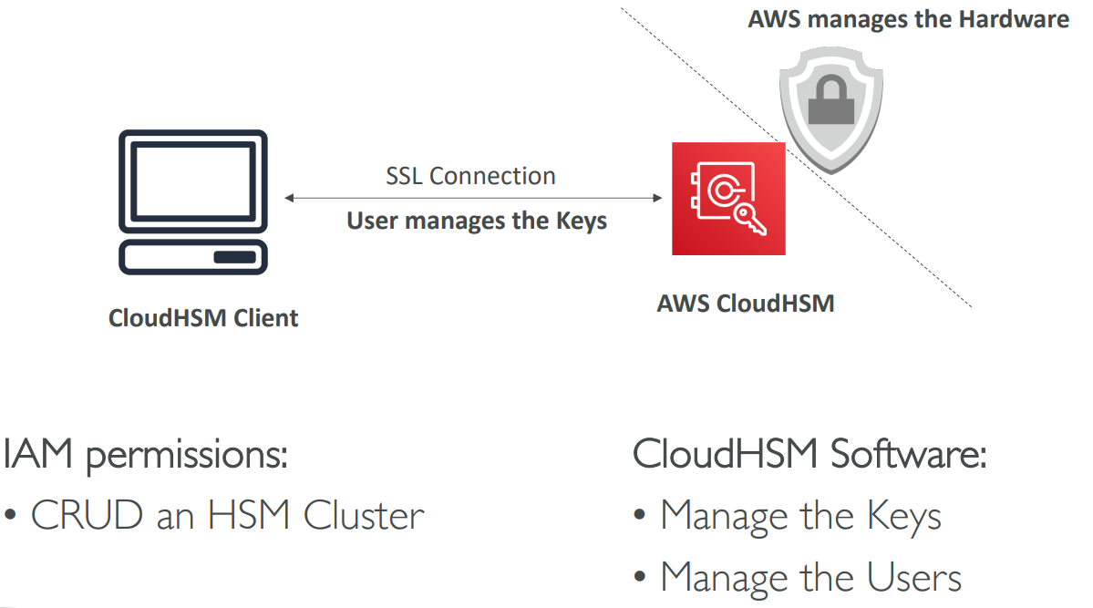
CloudHSM Service
Usecases
  Offload the SSL/TLS Processing for Web Servers
  Protect the Private Key
  Enable Transparent Data Encryption (TDE) for Oracle Databases
Regional Service
Price: https://aws.amazon.com/cloudhsm/pricing

Slide 4
CloudHSM Service
Demo
  https://www.youtube.com/watch?v=Y6agOjSWAKU

Slide 5
Assignment
  Self-practice

Slide 6
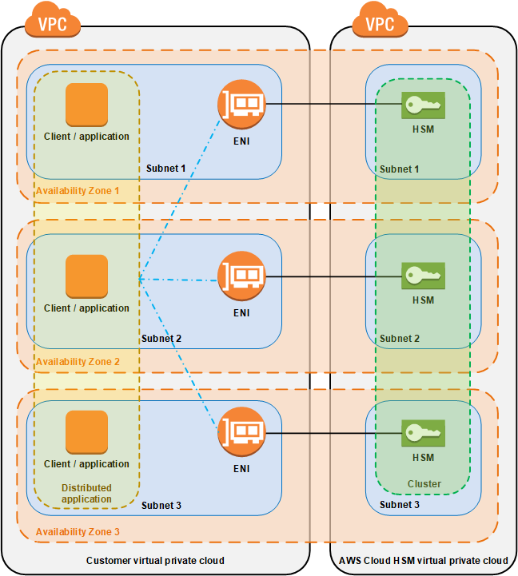
CloudHSM Service
Components
  Cluster
  HSM client instance
  HSM User

Slide 7
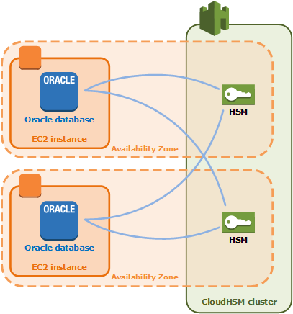
CloudHSM Service
  Cluster
    Contains a list of HSM instances self-synchronizing and load balancing
    Settings: VPC, Subnet, Security group, Multi A-Z, Backup, …
  HSM client instance
    Is an EC2 Instance with AWS CloudHSM client software installed
    You can generate, store, import, export, and manage keys
    Max: 28 HSM/1 cluster

Slide 8
CloudHSM Service
  HSM User
    Allow access to HSM
    Not an IAM User
    4 types
      Precrypto Officer (PRECO)
      Crypto Officer (CO | PCO)
      Crypto User (CU)
      Appliance User (AU)
https://docs.aws.amazon.com/cloudhsm/latest/userguide/manage-hsm-users.html#understanding-users

Slide 9
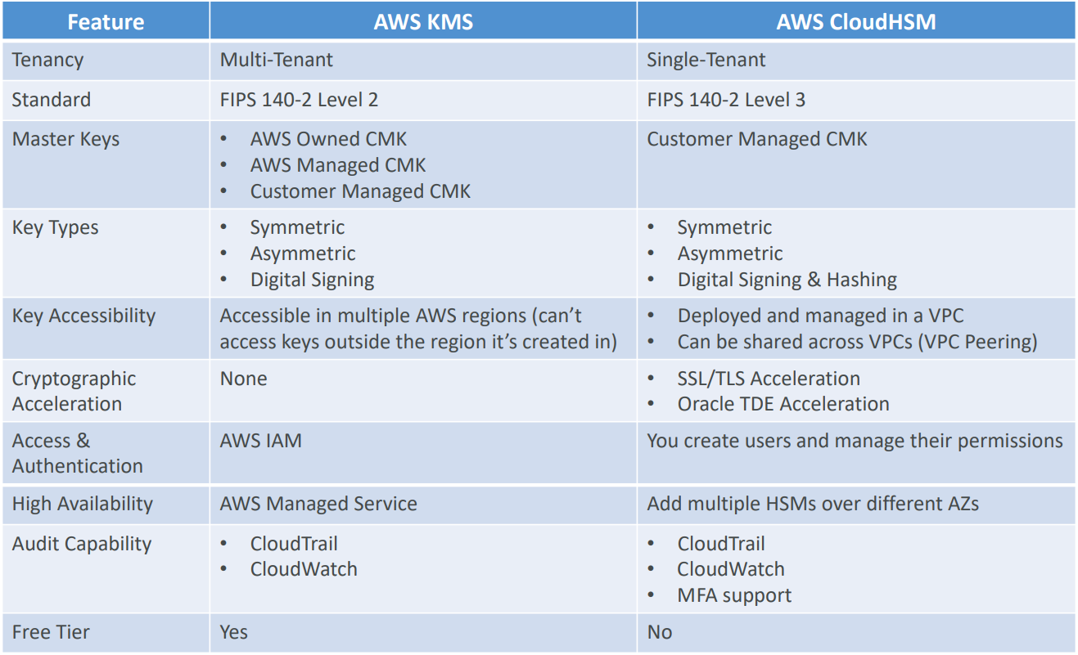
CloudHSM Service
Compare KMS & CloudHSM

Slide 10
Q & A
Copyright © VTI Academy All Rights Reserved

